Slide 1
Noisy label detection algorithm
-Rui Cai

Slide 2
Algorithm requirement
Input: the dataset D including a fraction of noisy labels
Output: A ranking R of the probabilities of being noisy labels for every samples. We need to choose the top K% samples seen as noisy samples.

Slide 3
Based on Image Classification
O2UNet
CurriculumNet
Co-teaching

Slide 4
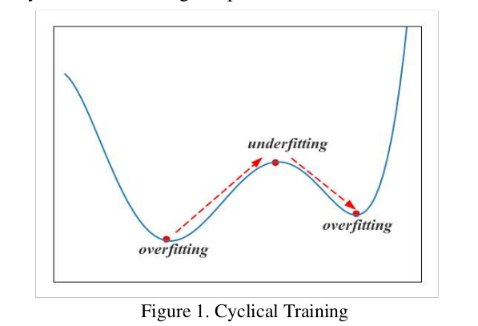
O2UNet–cyclic learning rate
Open source: https://github.com/hjimce/O2U-Net
Basic assumption:
当网络欠拟合时梯度主要由干净的样本决定.在开始阶段噪声样本的loss比干净样本大
Method:
跟踪每一个样本的loss在不同阶段的变动.使用循环学习率使模型从欠拟合和过拟合的状态中来回切换

Slide 5
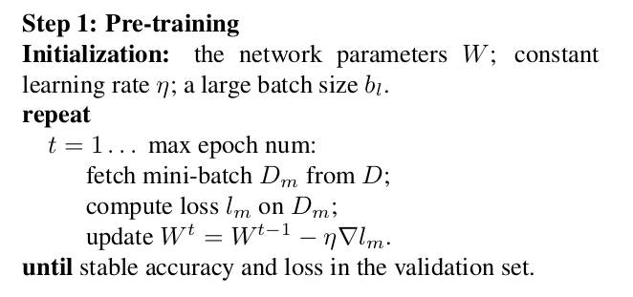
Pipeline of O2UNet
第一步预训练

Slide 6
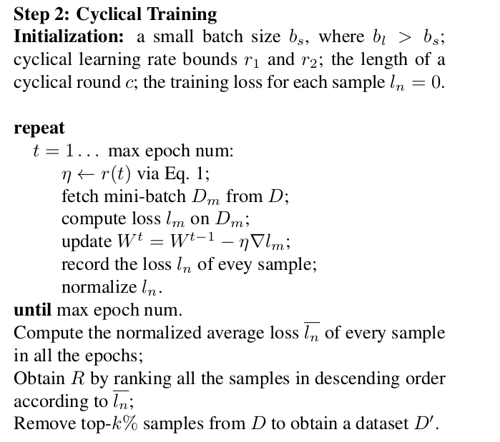
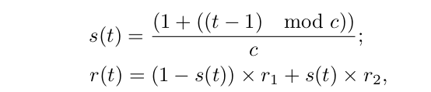
Pipeline of O2UNet
第二步循环训练
Cyclic Learning Rate:
C is the total number of epochs, t is the current epoch, learning rate r(t) is a convex combination of s(t)

Slide 7
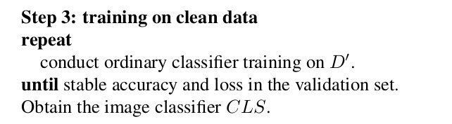
Pipeline of O2UNet
第三步在筛选后的干净样本上训练
Exclude the noisy samples and train on clean data for comparison

Slide 8
Experiment
Datasets: CIFAR-10, CIFAR-100,Mini-ImageNet, Clothing1M
Add Noisy Labels:
每个样本有随机概率p被独立的指定到另一个非原本标签的标签上(符合均匀分布)
Baselines:
Direct Training
Training with Bootstrapping
Co-teaching
MentorNet
Curriculum-Net

Slide 9
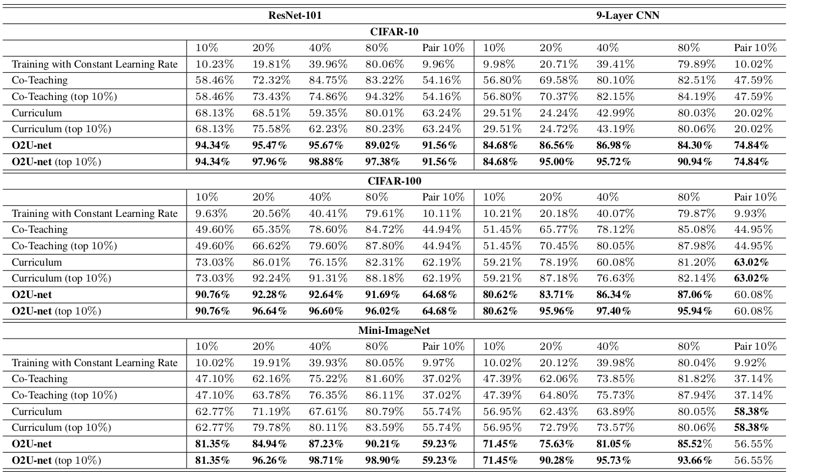
Result of the precision of the Noisy samples detection

Slide 10
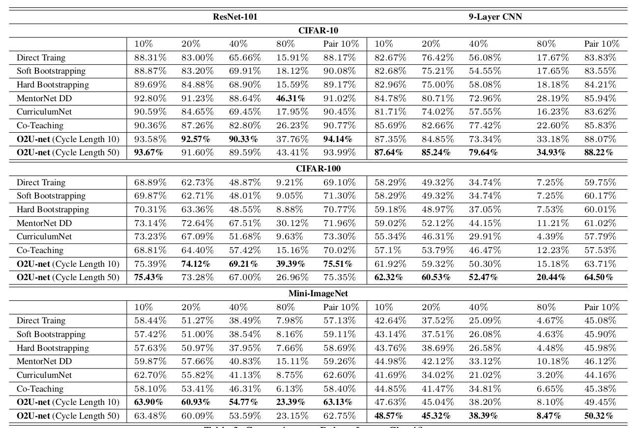
Result of the accuracy of image classification after noisy samples detection

Slide 11
CurriculumNet
https://github.com/guoshengcv/CurriculumNet
Motivation:
对于机器学习来说，模型开始的时候学习一个概念的简单的方面，然后逐渐学习更加复杂的方面
Pipeline:
Initial feature generation
Curriculum design
Curriculum learning

Slide 12
Initial feature generation
使用全部的样本训练一个initial model，应用于计算一个deep representation(eg. FC层的特征)

Slide 13

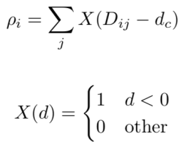

Curriculum Design
Aim: rank subsets of whole training set with complexity
Design:
承接上一步预训练模型(InceptionV2),得到FC层每个样本对应的特征
计算每个样本特征之间的欧氏距离
定义每个样本在特征空间中对应的局部密度
其中d_{c}是把第二步中所有距离从小到大排序，排在第k%的值
局部密度公式理解为对于样本i来说，在空间中所有距离小于dc的特征的个数
定义新距离指标判断聚类中心
距离指标理解为对于样本i来说，若存在局部密度比i高的点，取这些点离i最近距离作为距离指标，否则取所有样本离i的最远距离作为距离指标
排在前面几位的就是聚类中心
运用k-means生成聚类，文中生成了clean, noisy, highly noisy三类
定义局部密度参数的原因：
干净的样本在特征空间中更密集，从而导致局部密度上升，噪声样本具有多样性，在空间中很稀疏

Slide 14
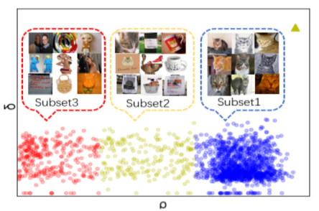
Unsupervised method
Dataset: all images in the category of cat from the WebVision
最右边最为密集，是clean dataset, 左边很稀疏，是noisy dataset，中间最为稀疏，是highly noisy dataset，使用聚类密度代表了样本集的复杂性，从而排序

Slide 15
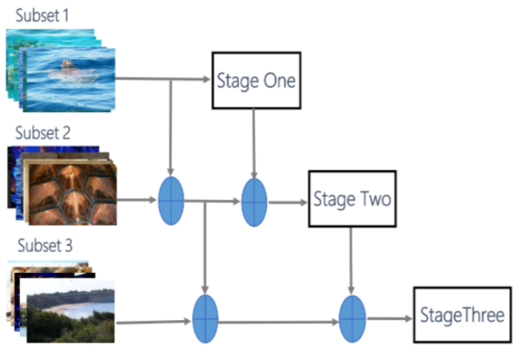
Curriculum Learning
Train on clean subsets of data
Train on clean and noisy subsets of data
Clean samples with loss weights 1
Noisy samples with loss weights 0.5
Train on clean, noisy and highly noisy subsets of data
Loss weights: 1, 0.5, 0.5
The model becomes more generalized

Slide 16
Experiment
Datasets:
WebVision2017
10000 classes with 2439574 pics without annotation, only 100,000 manually labeled images
50000 as train and val, 50000 as test
Clothing1M
1 million noisy samples and 74000 pics as ground truth
Ground truth(clean dataset) divide into 50,000, 14,000, 10,000 as train, val, test
Food-101
101 classes with 101000 pics, manually add 20% noisy labels into the training set
750 for train, 250 for test per category

Slide 17
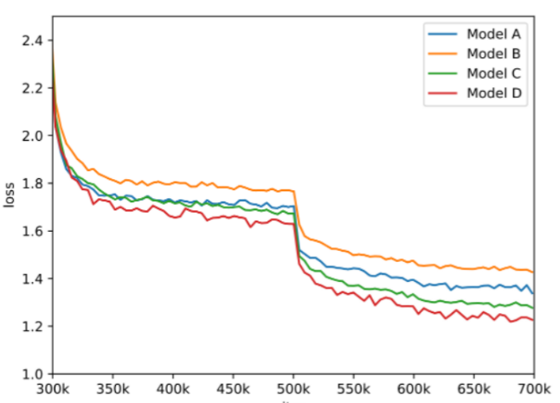
Comparison
Training strategy:
Model A: train by directly using the whole training set
Model B: train by only using the clean subset
Model C: train by using the 2-subset curriculum: clean and noisy subsets
Model D: train by using the whole 3-subset curriculum
Test loss of 4 models on val set of WebVision

Slide 18
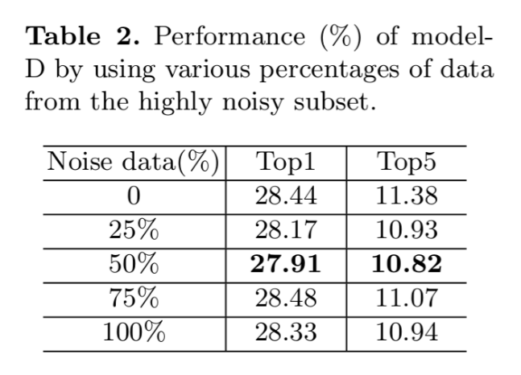
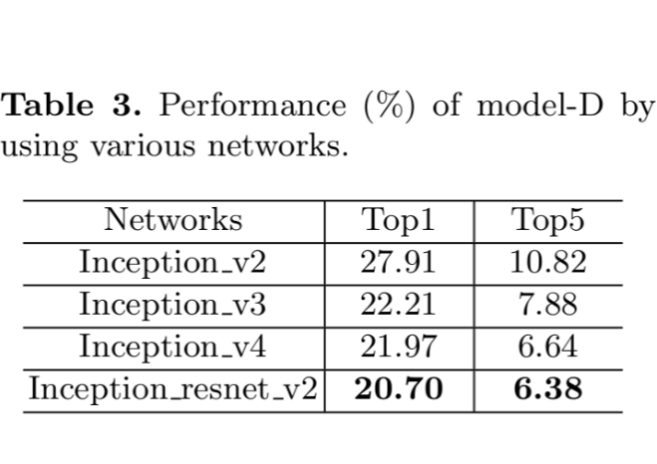

Slide 19
读取gt图片信息和pred图片信息
判定为FP问题
读取gt图片每一个方框b的信息
根据自适应范围内中心点匹配搜索pred中的目标中心点，存到target points集合里
是
计算target points中每一个点和b的iou，把满足大于阈值的点信息保存在matched points中
否
是
判定为FP问题
matched points是否为空
target points是否为空
否
将iou值最大的box作为匹配方框match box，标记为visited
是
根据分段检测噪声样本方法
判断match box的标签是否和b标签一致
判定为Label问题
否
把pred中未标记visited的物体取出
否
是
判定为FN问题
判断物体是否高于置信度阈值

